Slide 1
Serious Game for Management of IT-Projects

Slide 2

Hallo!
Ich bin Ixhen Hasani
Geboren am 05.08.1994 in Tirana, Albanien
Student im 5.Semester B.Sc,
Studienfach: Wirtschaftsinformatik
Software Entwickler Werkstudent bei Sulzer GmbH

Slide 3
“If you do what you love, you'll never work a day in your life.”

Slide 4
Und was mag ich machen?
Code
Aus einer Idee, kommt eine Liste von Anforderungen. Davon wird ein Plan abgeleitet und nach viele viele Stunden Eintippen und noch viel mehr Bugs entsteht ein Produkt, worauf man stolz ist.
Business
Die Einheit der Punkte in das Lebenspunktsystem ist $. Je mehr Punkte, desto mehr Personen kann man helfen, was eigentlich mein größtes Ziel entspricht.

Slide 5
Proffesioneles Ziel
Programmierer
Ich
Fachwirt

Slide 6
Worum geht es bei meinem Projekt ?
Viele IT Projekte scheitern
The Project Management Institute’s 2017 Pulse of the Profession report found that “due to poor project performance, organizations waste an average of $97 million for every $1 billion invested.”

Slide 7
Worum geht es bei meinem Projekt ?
Viele IT Projekte scheitern UND Managers sind der Hauptgrund
According to IBM “only 40% of projects meet schedule, budget and quality goals. Further, they found that the biggest barriers to success are people factors.”

Slide 8
Was ist die Lösung?

Slide 9

Ein Serious Game entwickeln!

Slide 10
Was ist ein Serious Game ?
Unter Serious Games versteht man digitale Spiele, die nicht primär oder ausschließlich der Unterhaltung dienen, wohl aber derartige Elemente enthalten können.

Slide 11
Warum ein Serious Game ?
Mehr Engagement
“...The results we obtained so far lead us to believe that serious game design has a direct and indirect effect over student’s perceived acquired competency, which is mediated by student's engagement”
Bonazzi, R (2011). Analysis of Serious Games Implementation for Project Management Courses.

Slide 12
Warum ein Serious Game ?
Besseres Management
“...the Gamification of the educational part of project management actually leads to better managed projects in the real business environment.
Briers, B. (2013). The gamification of project management.

Slide 13
Wo kommt die Theorie her ?
PMBOK-Guide(Software Extension)
Definiert als Zusammenfassung des Wissens der Fachrichtung (Software)Projektmanagement
Kollektion von Best Practices und Vorgehensweisen für Management der IT-Projects
(!!Insert PMBOK Book Pic down here)

Slide 14
In two or three columns
Yellow
Is the color of gold, butter and ripe lemons. In the spectrum of visible light, yellow is found between green and orange.
Blue
Is the colour of the clear sky and the deep sea. It is located between violet and green on the optical spectrum.
Red
Is the color of blood, and because of this it has historically been associated with sacrifice, danger and courage.

Slide 15
App Design
User bekommt die Erklärung eines Konzeptes in Snack-Size Minikapiteln
User wird durch Quizze, Lückentexten usw. nach bereits erklärten Konzepten gefragt
Punksystem einbauen, was den Fortschritt des Users misst.
App Photo hier einfügen

Slide 16
Problemstellung
The Project Management Institute’s 2017 Pulse of the Profession report found that “due to poor project performance, organizations waste an average of $97 million for every $1 billion invested.”
According to IBM “only 40% of projects meet schedule, budget and quality goals. Further, they found that the biggest barriers to success are people factors.”
Insert Chart Here, from PowerPoint on Windows
Notes:
https://www.cio.com.au/article/625522/why-it-projects-still-fail/

Slide 17
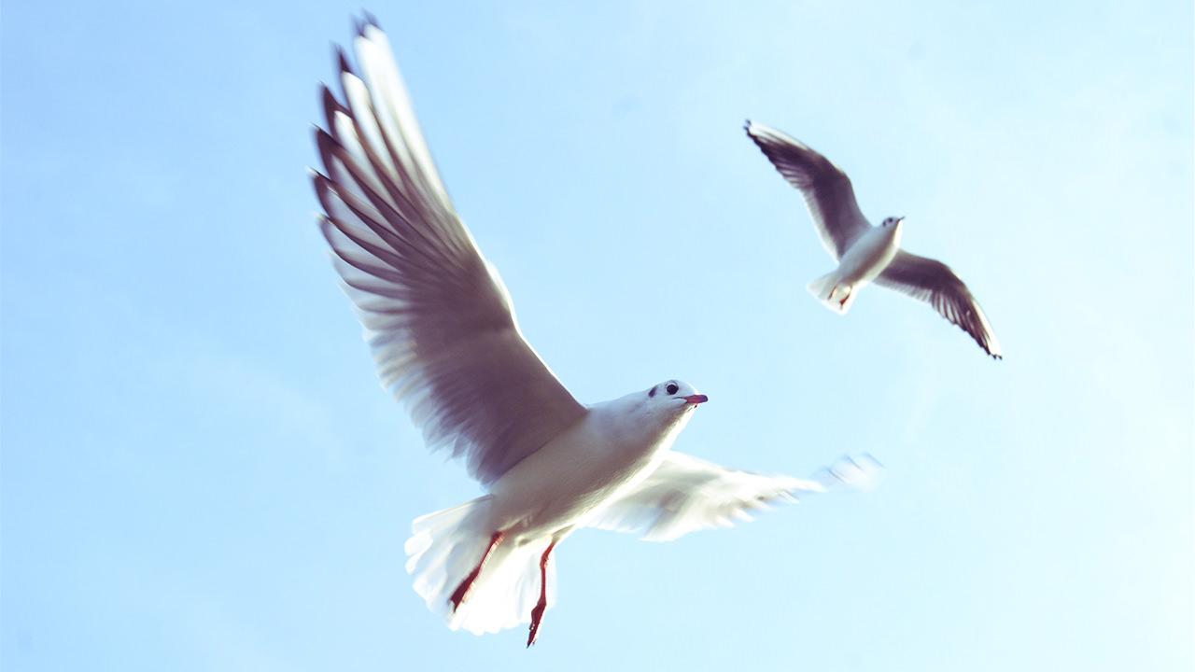
Want big impact?
Use big image.

Slide 18
And tables to compare data
 | A | B | C
Yellow | 10 | 20 | 7
Blue | 30 | 15 | 10
Orange | 5 | 24 | 16

Slide 19
Maps
our office

Slide 20
89,526,124
Whoa! That’s a big number, aren’t you proud?

Slide 21
89,526,124$
185,244 users
100%
That’s a lot of money
And a lot of users
Total success!

Slide 22
Our process is easy
first
second
last

Slide 23
Our sales funnel
20%
40%
60%
80%
Diagram featured by http://slidemodel.com
100%

Slide 24
Let’s review some concepts
Yellow
Is the color of gold, butter and ripe lemons. In the spectrum of visible light, yellow is found between green and orange.
Blue
Is the colour of the clear sky and the deep sea. It is located between violet and green on the optical spectrum.
Red
Is the color of blood, and because of this it has historically been associated with sacrifice, danger and courage.
Yellow
Is the color of gold, butter and ripe lemons. In the spectrum of visible light, yellow is found between green and orange.
Blue
Is the colour of the clear sky and the deep sea. It is located between violet and green on the optical spectrum.
Red
Is the color of blood, and because of this it has historically been associated with sacrifice, danger and courage.

Slide 25
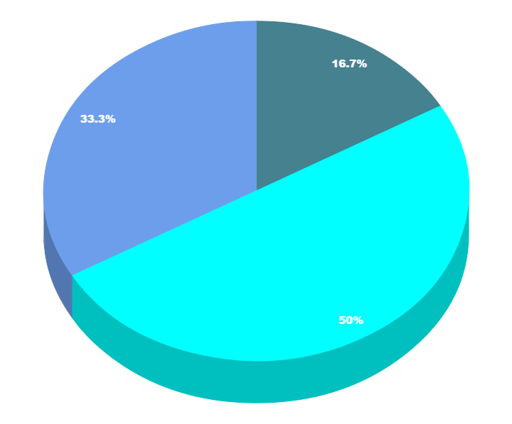
You can copy&paste graphs from Google Sheets

Slide 26
Place your screenshot here
Android project
Show and explain your web, app or software projects using these gadget templates.

Slide 27
Place your screenshot here
iPhone project
Show and explain your web, app or software projects using these gadget templates.

Slide 28
Tablet project
Show and explain your web, app or software projects using these gadget templates.

Slide 29
Place your screenshot here
Desktop project
Show and explain your web, app or software projects using these gadget templates.

Slide 30
Danke für die Aufmerksamkeit!
Fragen?

Slide 31
Credits
Special thanks to all the people who made and released these awesome resources for free:
Presentation template by SlidesCarnival
Photographs by Unsplash

Slide 32
Presentation design
This presentation uses the following typographies and colors:
Titles: Nixie One
Body copy: Muli
You can download the fonts on this page:
https://www.fontsquirrel.com/fonts/nixie-one
https://www.fontsquirrel.com/fonts/muli
Aquamarina #00e1c6 / Turquoise #19bbd5 / Skyblue #2c9dde /
Light gray #c6daec / Dark blue #0e293c
You don’t need to keep this slide in your presentation. It’s only here to serve you as a design guide if you need to create new slides or download the fonts to edit the presentation in PowerPoint®

Slide 33
SlidesCarnival icons are editable shapes.
This means that you can:
Resize them without losing quality.
Change fill color and opacity.
Change line color, width and style.
Isn’t that nice? :)
Examples:

Slide 34
😉
Now you can use any emoji as an icon!
And of course it resizes without losing quality and you can change the color.
How? Follow Google instructions https://twitter.com/googledocs/status/730087240156643328
✋👆👉👍👤👦👧👨👩👪💃🏃💑❤😂😉😋😒😭👶😸🐟🍒🍔💣📌📖🔨🎃🎈🎨🏈🏰🌏🔌🔑 and many more...

